Slide 1
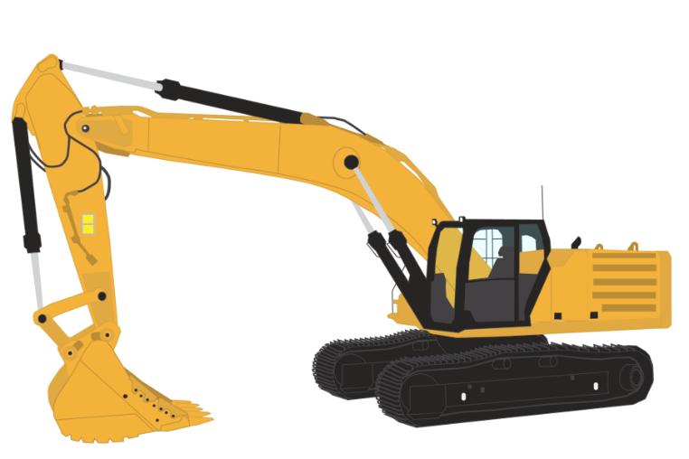

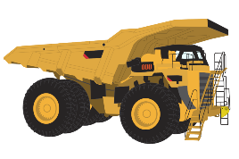
Project 2
Interactive mining INCIDENT dashboard
By Grant Towers and Nicholas Mcmahon

Slide 2

Contents
Data Story/Sourcing
ETL Process
Dashboard
Visualization 1 – Mine Details Data Tablet
Visualization 2 – Dual Dataset Injury Donut
Visualization 3 – Stacked Bar Incident Activities by Month
Visualization 4 – Bar Chart of Incidents By Category

Slide 3
Data Story
A couple of weeks back the Safety Team have requested we prepare a new database for the storage and query (as required), of regulator (external) injury data from 2020. This database allowed the team to complete analysis of our company injuries with industry, the time has come to make this fantastic new database useful.
So, following the Safety Team's exemplary feedback relating the ETL Project, they have now asked for detailed interactive Dashboard to view the top 20 mining companies' injury data.

Slide 4
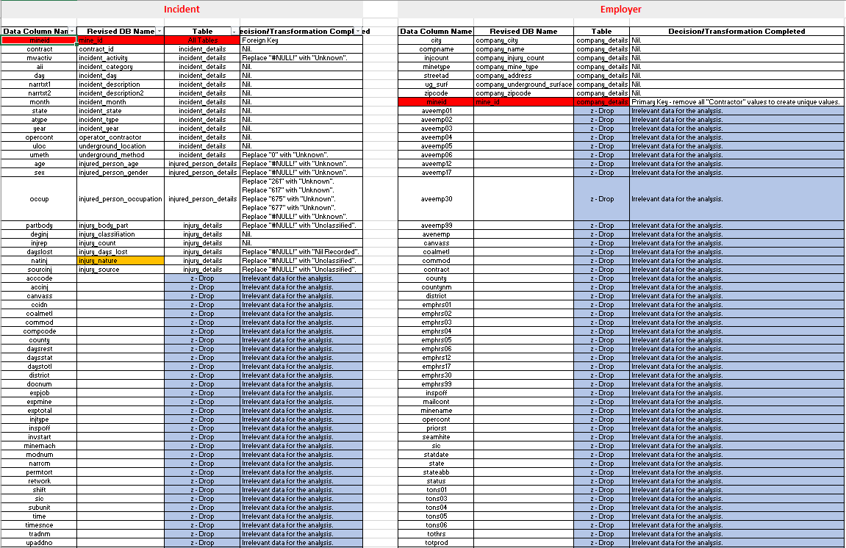
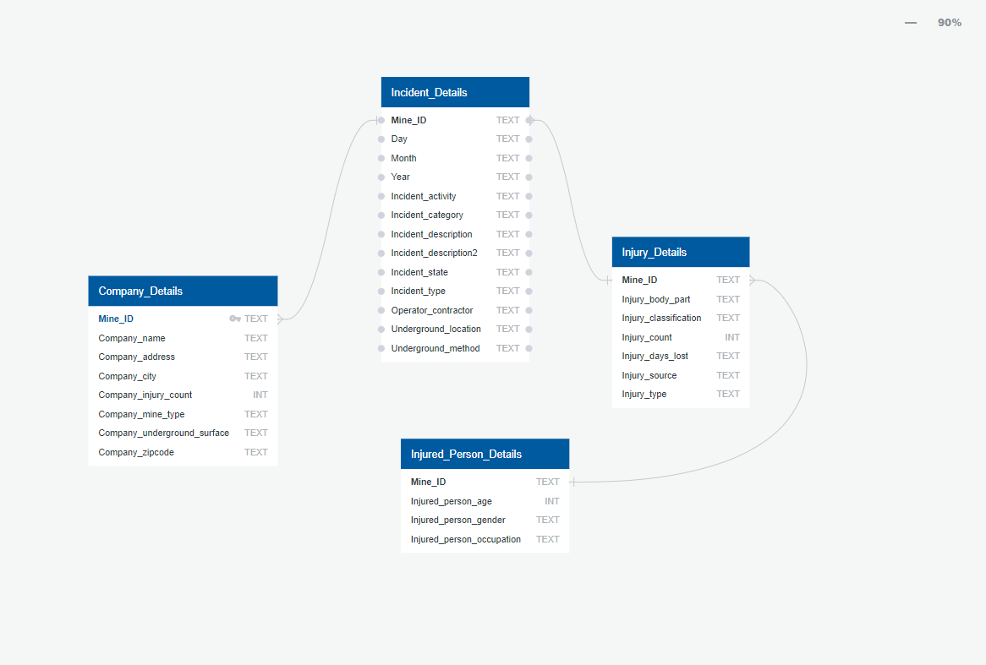
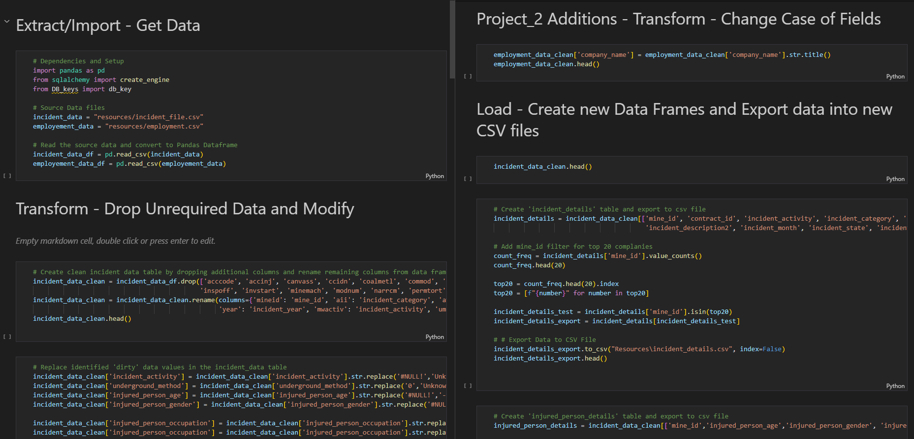
ETL Process
Data Sourcing and Extraction
Source data from https://www.cdc.gov/niosh/mining/data/ and download relevant CSV datasets
Using Excel and http://www.quickdatabasediagrams.com we dissected the tables and produced a schema
Transformation of Data
Import all Dependencies and setup CSV Panda reads.
Create clean incident/employment data table by dropping additional columns and rename remaining columns from data frames.
Loading Data
Create Incident_data Database in Postgres pgAdmin4
Create the four tables as seen in the image to the left.
Replace identified 'dirty' data values in the incident_data table.
Group and count the Top 20 Mine sites and filter tables to only include those.
Create a database connection to postgres and Load data into tables.

Slide 5
Dashboard

Slide 6
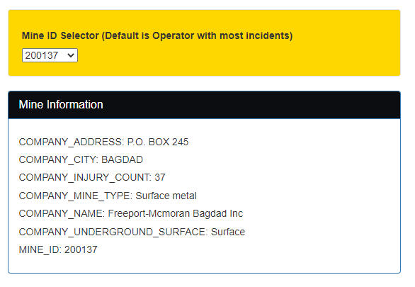
Visualization 1 Mine Information Overview Data: - Imported using the mine_id, importing an overview of the Mines information. Visualisation Source: - Generated using plot.ly

Slide 7
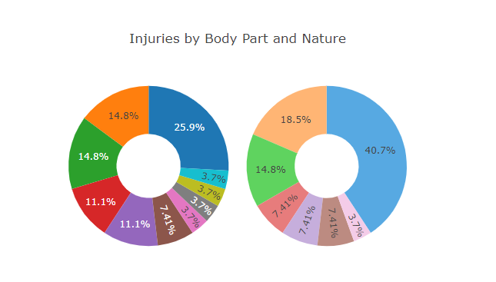
Visualization 2 Dual Dataset Injury Donut Data: - Imported using the mine_id as a filter, then presenting the mines injury data by Body Part and also Nature. Visualisation Source: - Generated using plot.ly

Slide 8

Visualization 3 Stacked Bar Incident Activities by Month

Slide 9
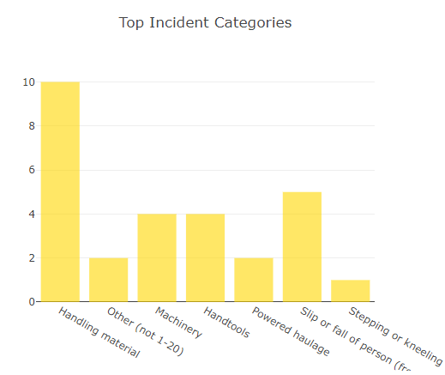
Visualization 4 Bar Chart of Incidents By Category

Slide 10
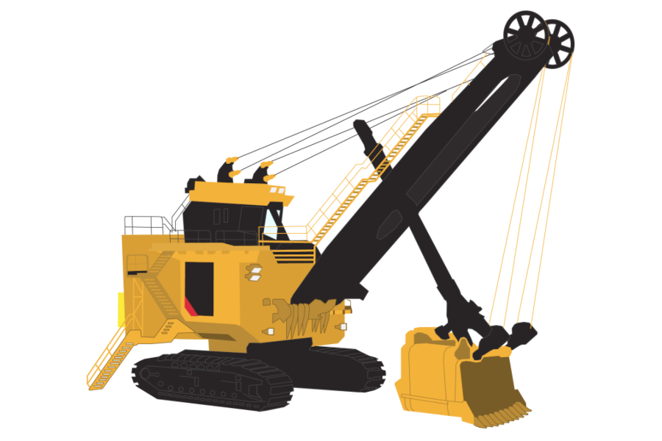

Thankyou for listening
Stay safe out there!

